Slide 1
Fast Track Funding & Programming

Slide 2
Repurposing of EPE State Aid
$20 million in EPE State Aid that has been removed from the match to federal Workforce Innovation Opportunities Act (WIOA) funds now focused on 3 initiatives:
Fast Track High School Equivalency (HSE) preparation;
National External Diploma Program (NEDP) High School Equivalency programming;
NRS Level 1 ABE students as determined on the TABE 11 & 12 assessment.

Slide 3
Accountability for Fast Track
National
Reporting System
NRS
New York’s
Reporting System
NYRS

Slide 4
Fast Track High School Equivalency (HSE) Preparation
Fast Track Math GRASP packets
Six (6) hour intense instruction sessions
Two x Two sessions focus on 2 subtest topics
Test taking skills and strategies
Computer based testing skills and strategies

Slide 5
Fast Track Math GRASP Packets
Fast Track Funding

Slide 6
Fast Track Math GRASP Packets
The only option for Fast Track that was designed to be Distance Education
Sixteen (16) packets are available to assign to individual students
Credit is achieved when the teacher ascertains the student has mastered the skills in the packet
Packets cannot be repeated, once a packet is recorded as complete, it cannot be use again

Slide 7

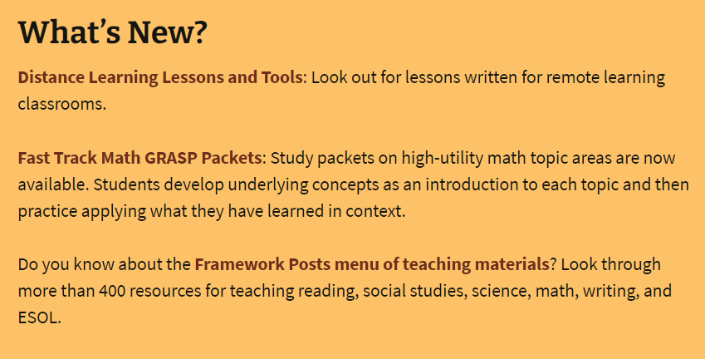
Fast Track Math GRASP Packets

Slide 8
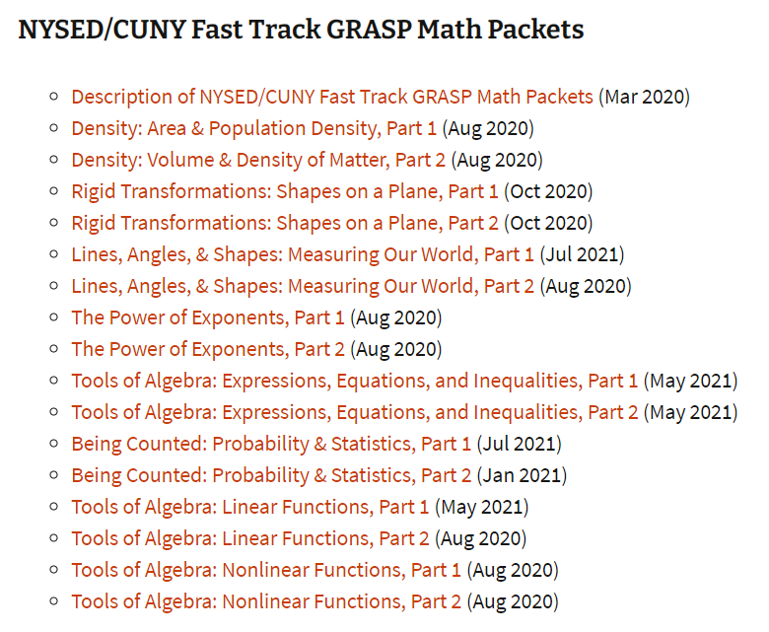
Fast Track Math GRASP Packets

Slide 9
New York’s Reporting System (NYRS)
No NRS requirement that students must attend 12 hours;
No valid pre or post-test requirement;
No Measurable Skill Gain calculated;
All participants must be tested with the HSE readiness assessment;
No employment follow-up for students/test takers; and
No requirement for HSE diploma recipients to have employment or postsecondary training within the first year after ext.
Fast Track Students Only

Slide 10
Fast Track Math GRASP Packets
Fast Track Math GRASP Packets conforms to the two-week packet model;
Documentation of student work must be kept for each completed packet. Refer to Appendix 6;
The instructor is responsible for reviewing the student’s work and assessing mastery of skills;

Slide 11
Fast Track Math GRASP Packets
ESL students preparing to take the HSE Math subtest may receive Fast Track GRASP Math Packets;
All teachers providing Fast Track GRASP Math packets must be adult education certified or K-12 NYSED certified;
A student roster, generated from the Instructional Offering in ASISTS must be maintained;
Each teacher providing Fast Track Math GRASP packets must have a separate class code in ASISTS where Appendix 6 results are recorded.

Slide 12
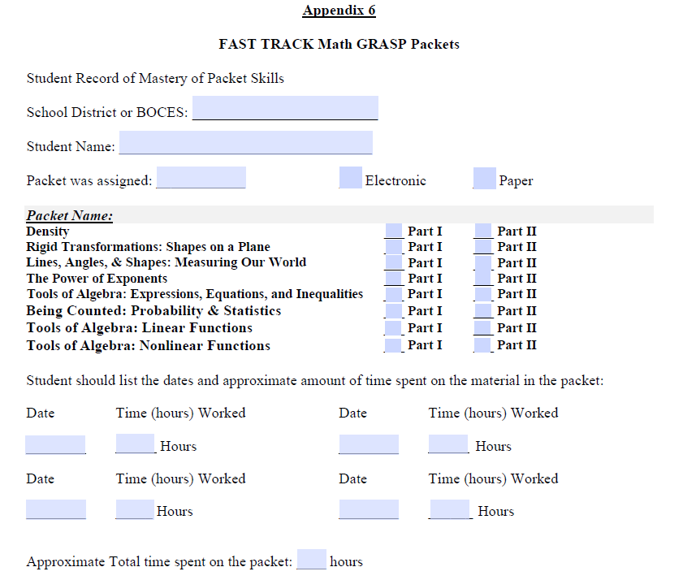
Fast Track Math GRASP Packets
Fillable Form
Completed by the Student

Slide 13
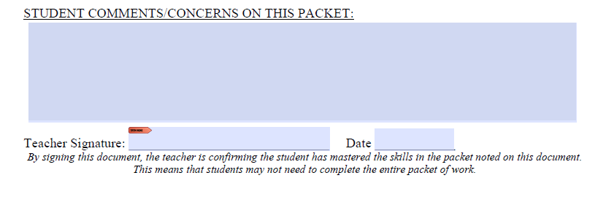
Fast Track Math GRASP Packets
Appendix 6 is signed and submitted by the teacher ONLY when the teacher ascertains the student has mastered the skills in that packet
Must be Signed by the Teacher

Slide 14
Fast Track Math GRASP Packets
Two Packets per month maximum
Each Appendix 6 signed by the teacher is credited 24 contact hours in ASISTS
A “4” is entered into a Fast Track Math GRASP class in ASISTS
That “4” is automatically multiplied by 6 for a total of 24 contact hours
Program enters an “8” in that month for attendance
That “8” is automatically multiplied by 6 for a total of 48 contact hours

Slide 15
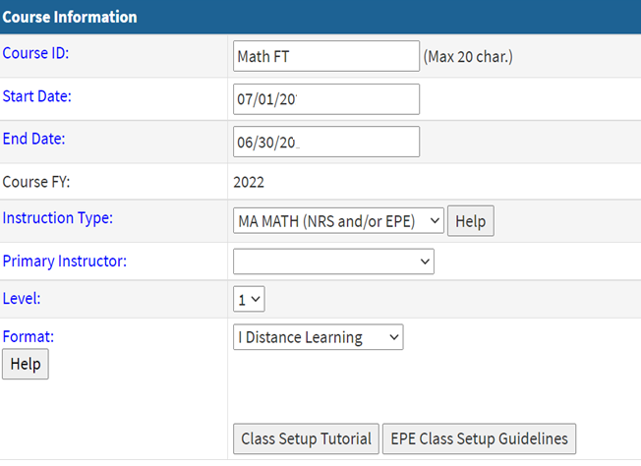
Fast Track Math GRASP Packets
Instructional Offering

Slide 16
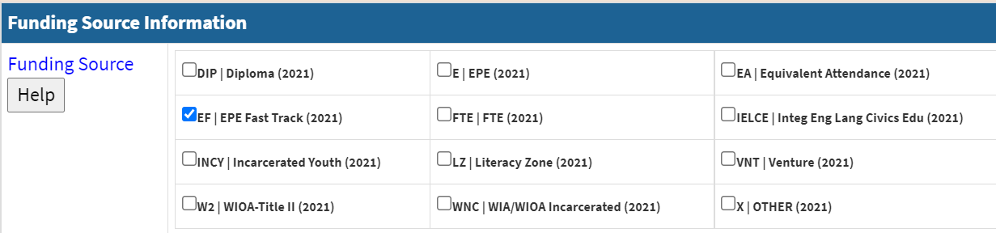
Fast Track Math GRASP Packets
Instructional Offering
Funding Source must be
EPE Fast Track

Slide 17
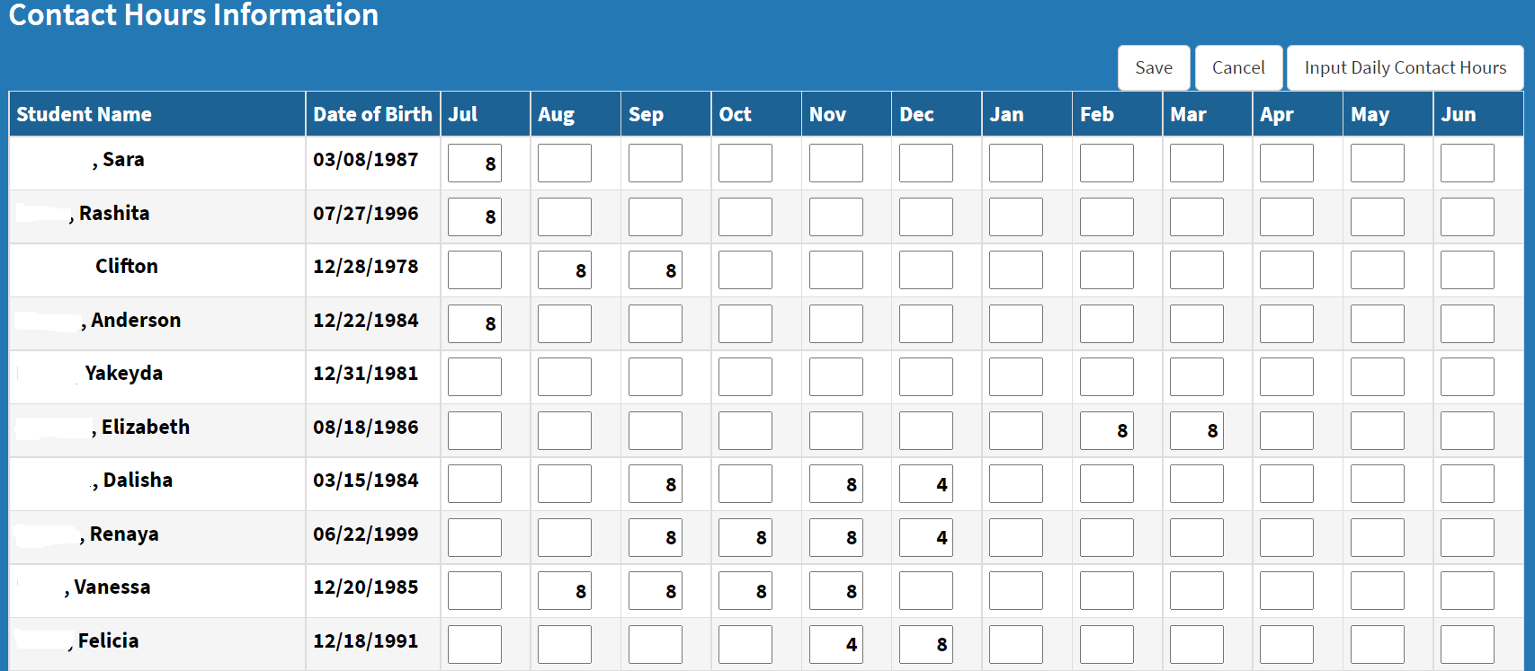
Fast Track Math GRASP Packets
Attendance

Slide 18
Fast Track Math GRASP Packets Tutoring
6 Hours of in-person tutoring per week
Must be focused on the math skills represented in the packets
Recorded as traditional classroom attendance in ASISTS

Slide 19
Fast Track Math GRASP Packets Tutoring
Can be enrolled in either GRASP, SMART, or ESL AND Fast Track Math GRASP Program
However
A maximum COMBINED total of 6 hours of tutoring per week if enrolled in GRASP, SMART, or ESL AND Fast Track Math GRASP Program

Slide 20
Fast Track Math GRASP Packets
Instructional Offering for
Tutoring
Funding Source must be
EPE Fast Track

Slide 21
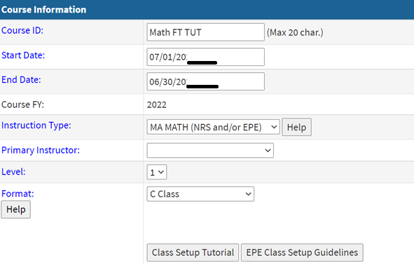
Fast Track Math GRASP Program
Tutoring Class

Slide 22
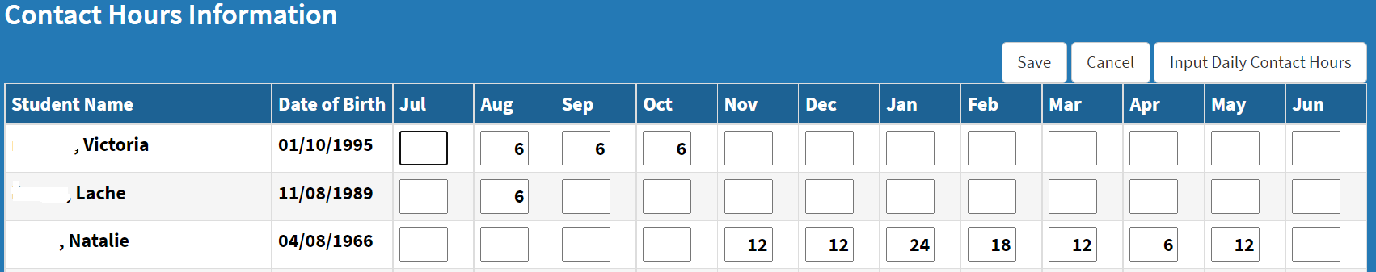
Fast Track Math GRASP Program
Tutoring Attendance

Slide 23
Fast Track Math GRASP Packets
Reminder:
Cannot repeat a packet once an Appendix 6 has been recorded in ASISTS
There are 16 packets
ASISTS tracks the packets over fiscal years
Packets were introduced in November 2018
All Appendix 6 documents are subject to audit
Must be audit ready and be provided upon request from the AEPP office, Accountability office or RAEN office

Slide 24
Fast Track Math GRASP Packets
Reminder:
Packets must remain as they are issued
Can be provided in print or electronically
Students can access the packets directly from CollectEdNY.org

Slide 25
Fast Track Math GRASP Packets
Reminder:
Teachers may choose to use lessons from the packets in the classroom
In those cases, the packets cannot subsequently be assigned to those students
Teachers may choose to design classroom lessons that mirror the skills in each packet but do not duplicate the lesson directly from the packet

Slide 26

QUESTIONS?

